Slide 1

SMART GPS TRACKER USING ARDUINO
REKHA V 19BCE1871

Slide 2

OBJECTIVE
•The proposed Arduino based tracking system uses global positioning system and global system using GSM modules. GSM module with a SIM card is used for purpose of communication.
•This system can be installed or hidden in your vehicle. After installing the circuit we can easily track the stolen vehicle using a mobile phone.
•Parents can also use this application to track their children by placing this circuit inside the school/college bag.

Slide 3
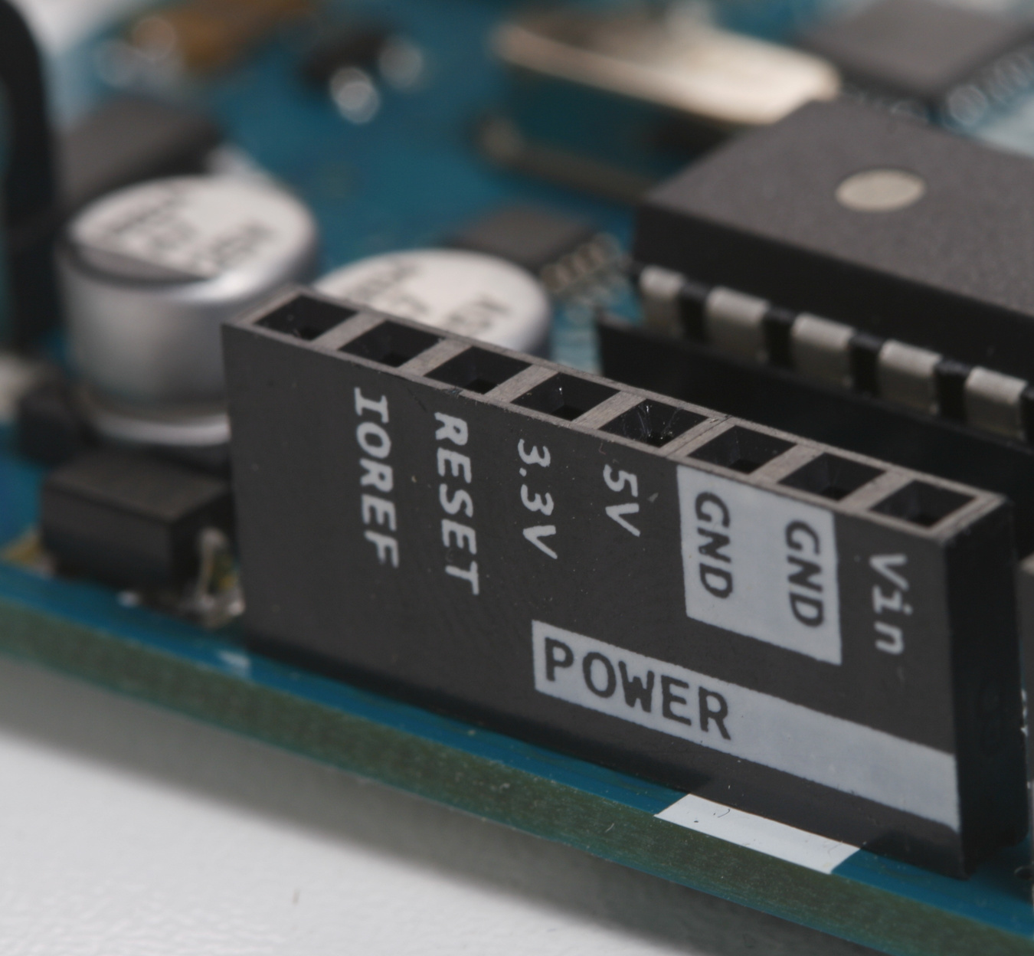
COMPONENTS REQUIRED:
· Arduino Uno
· GPS module
· GSM module
· Jumper wires

Slide 4
BLOCK DIAGRAM:
Cloud :ThingSpeak

Slide 5
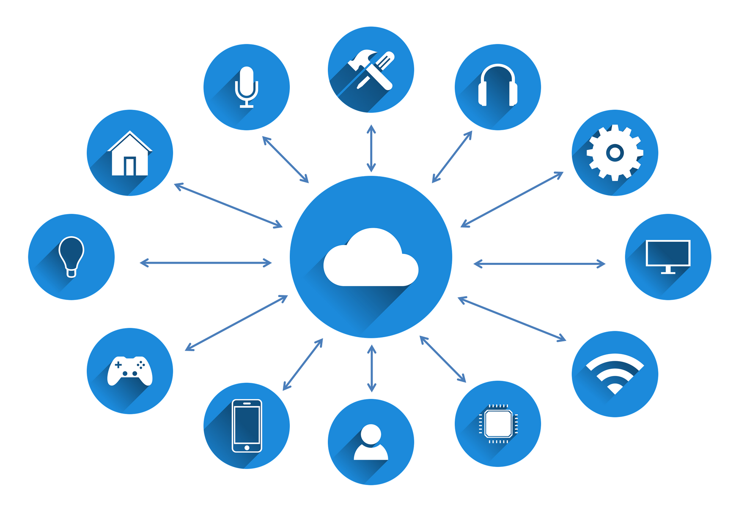
MODULES:
•GPS: To get the latitude and longitude.
•GSM: To receive messages and for communication.
•Arduino: Acts as an interface for GPS and GSM.
•LCD: To display the co-ordinates.
Connecting to the cloud i.e Thingspeak using cellular data of GSM

Slide 6

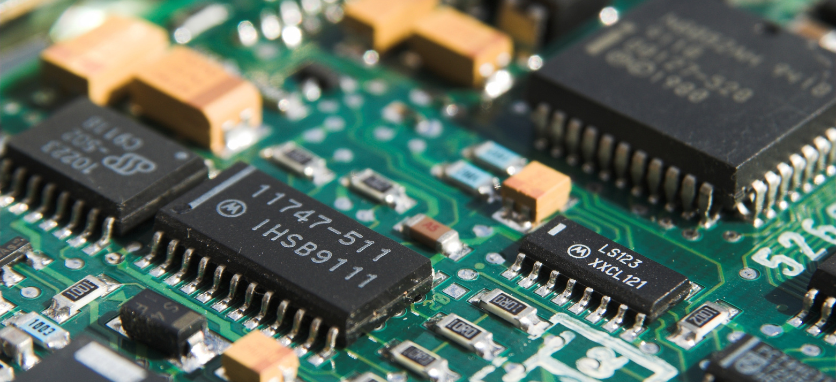
SOFTWARE SIMULATION TOOL
PROTEUS professional
HARDWARE TOOL
Arduino software
and hardware components

Slide 7
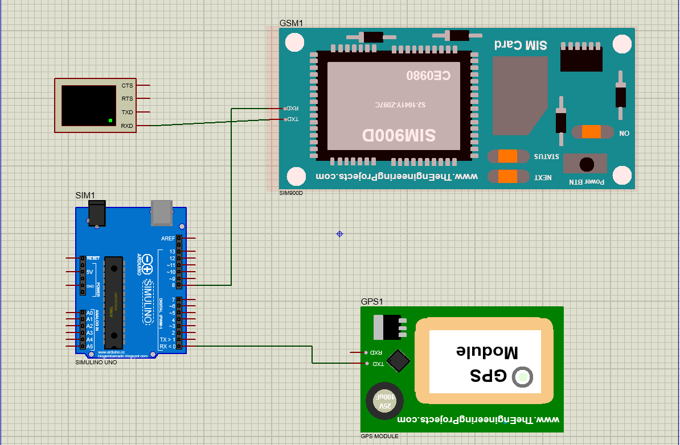
SOFTWARE SIMULATION USING PROTEUS PROFESSIONAL
circuit diagram

Slide 8
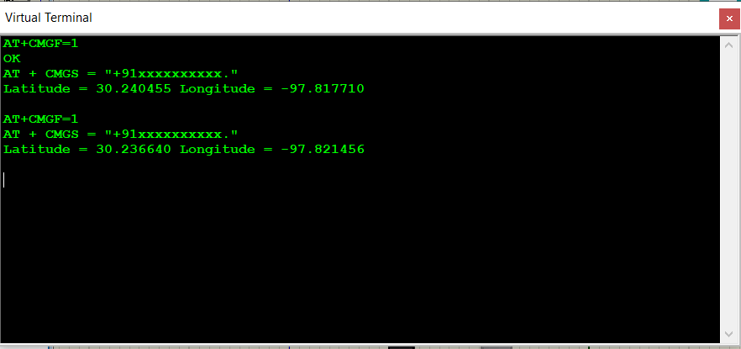
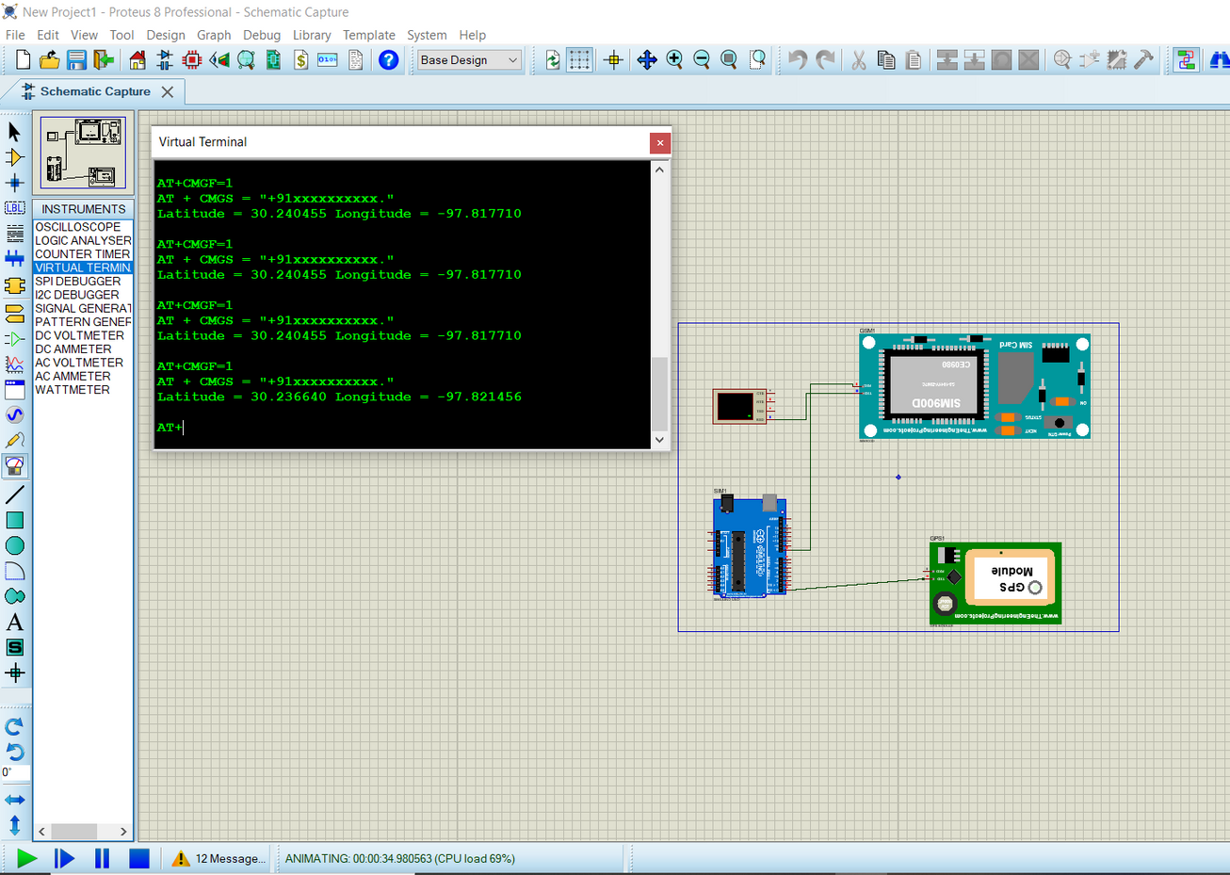
OUTPUT FROM SOFTWARE SIMULATION

Slide 9
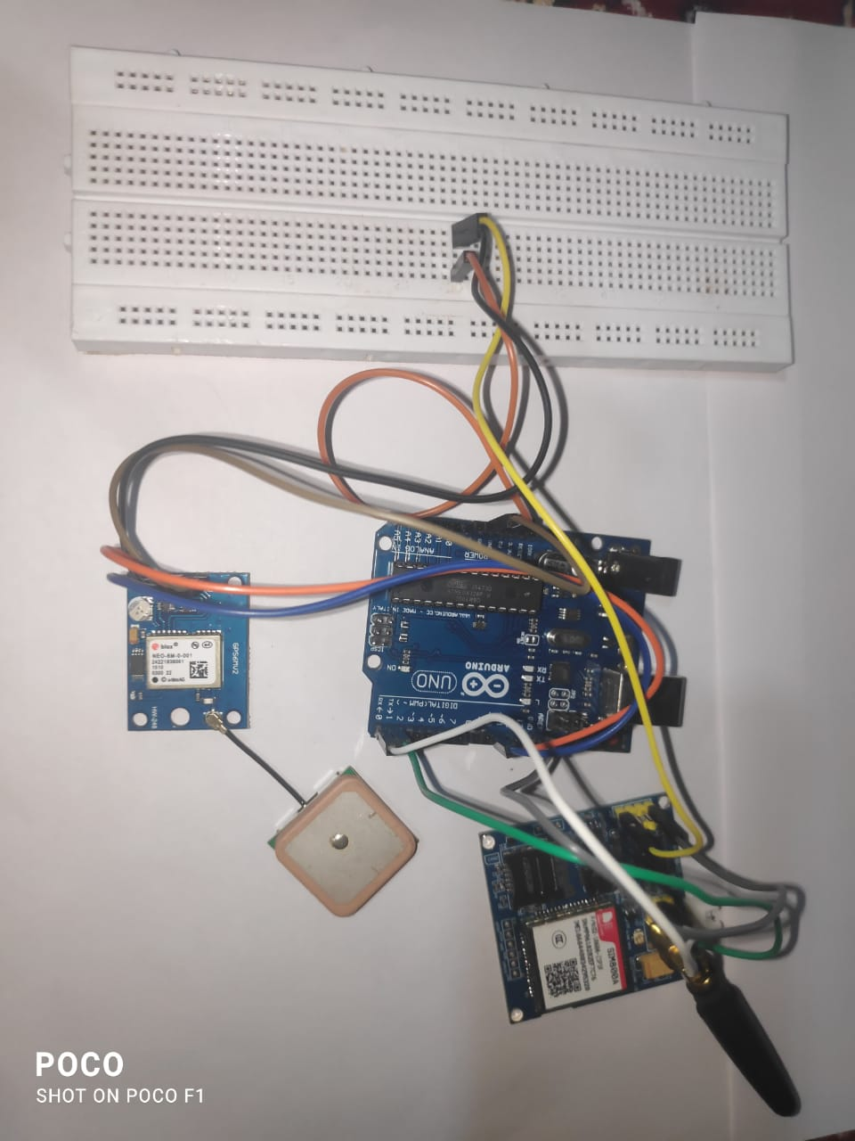
Arduino | GPS module
Digital pin 10 | RX pin
Digital pin 11 | TX pin
VCC – 5v | VCC
Ground | Ground
HARDWARE SIMULATION :
Arduino | GSM module
Digital pin RX | TX pin
Digital pin TX | RX pin
VCC – 5v | VCC
Ground | Ground

Slide 10
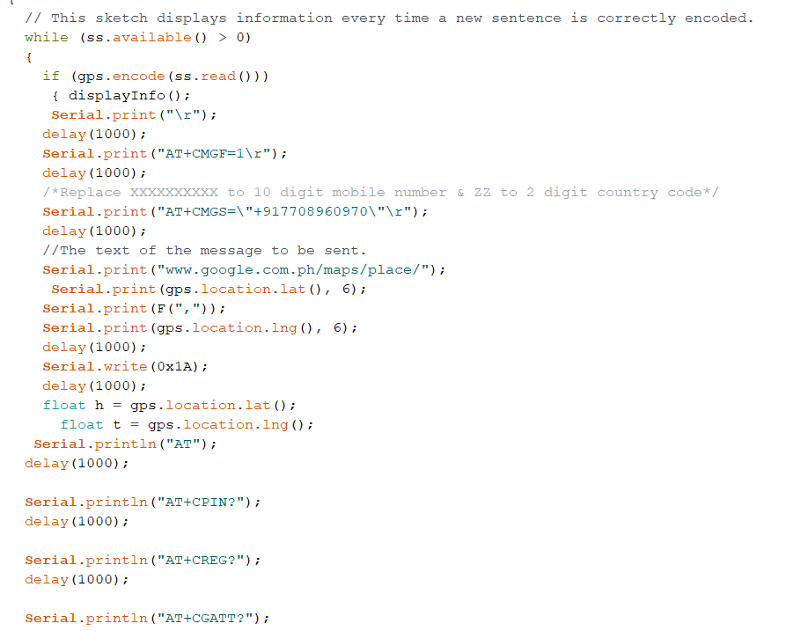
CODING:

Slide 11
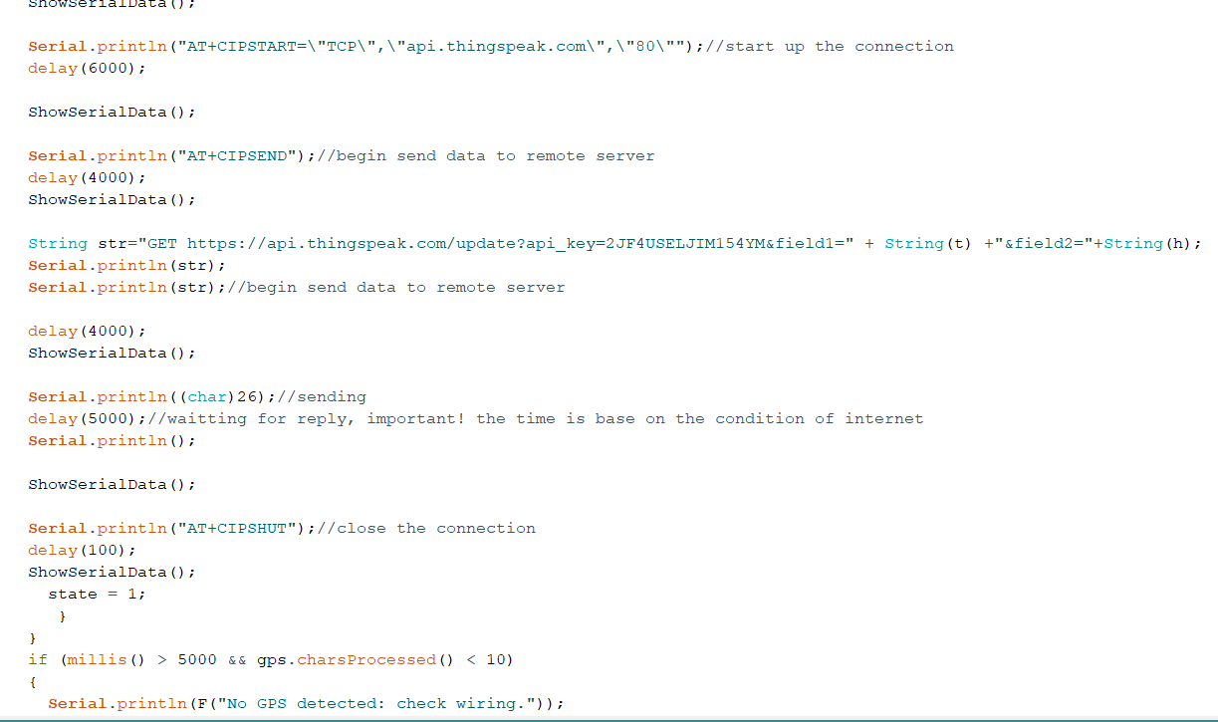
CODING:

Slide 12

IMPLEMENTATION OF THE PROJECT

Slide 13
THANK YOU
TEAM NAME:FRANCE

Slide 14
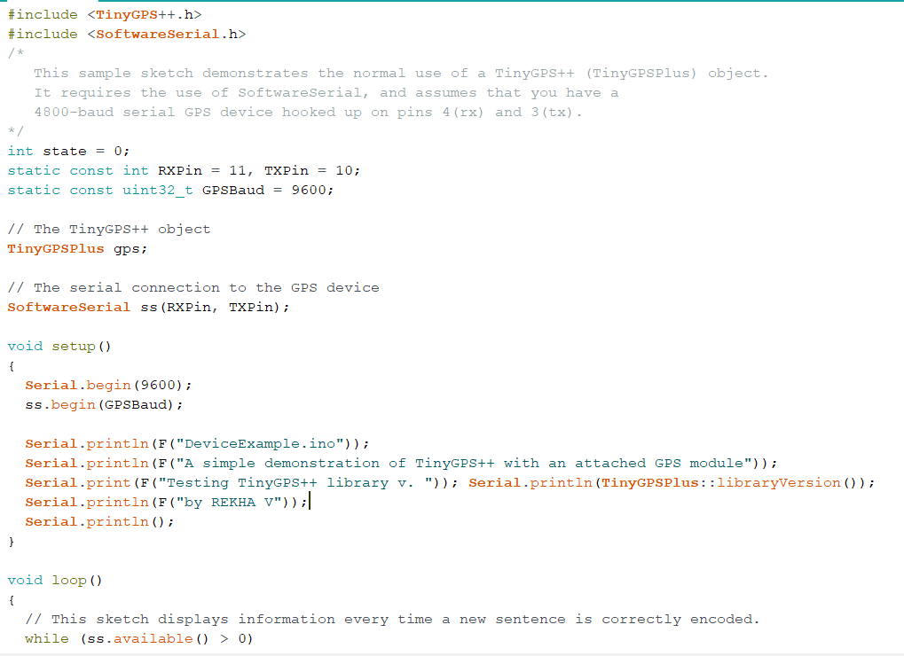
CODING:

Slide 15
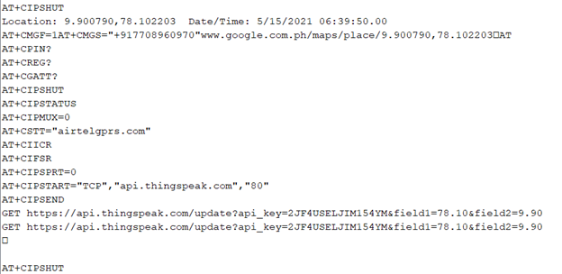
OUTPUT FROM SERIAL MONITOR:

Slide 16
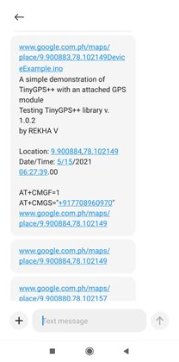
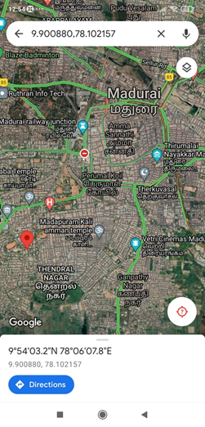
OUTPUT FROM THE MOBILE

Slide 17
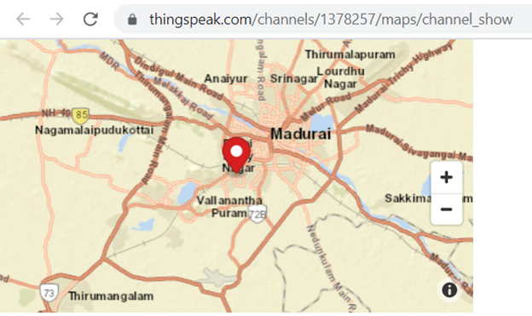
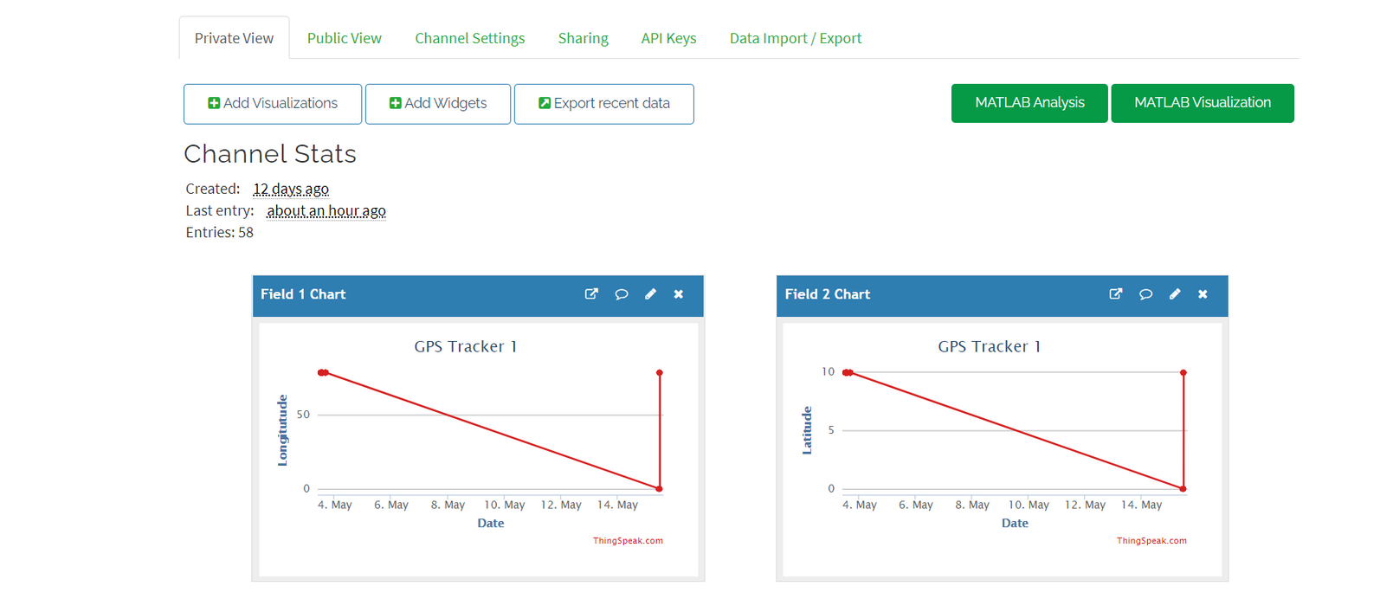
OUTPUT FROM ThingSpeak

